Slide 1
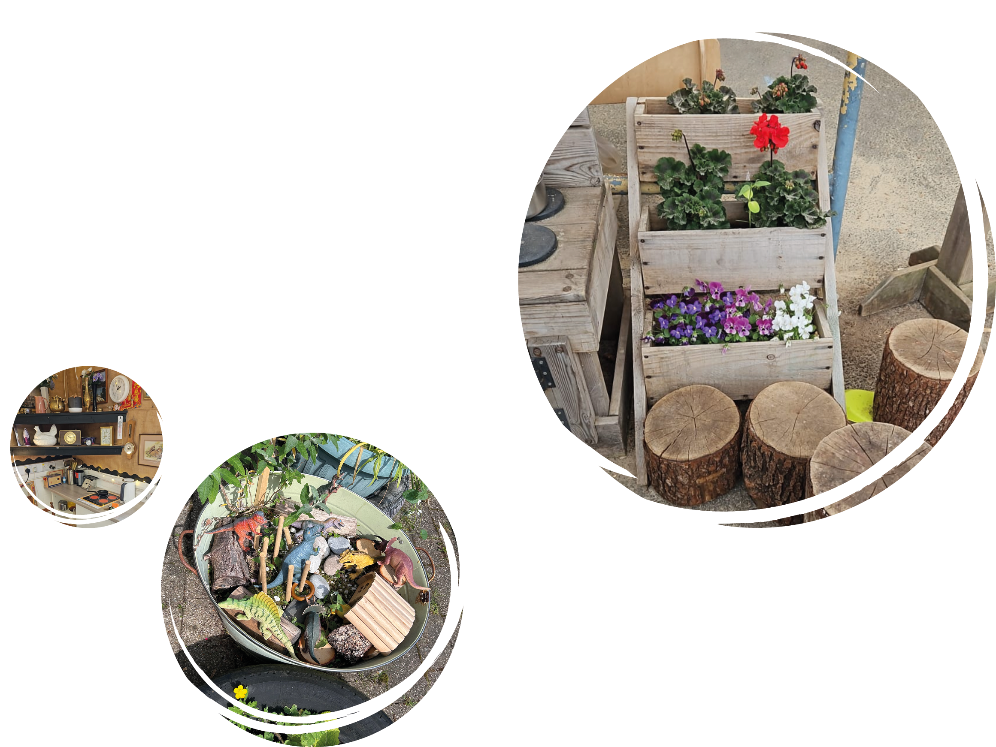

Slide 2
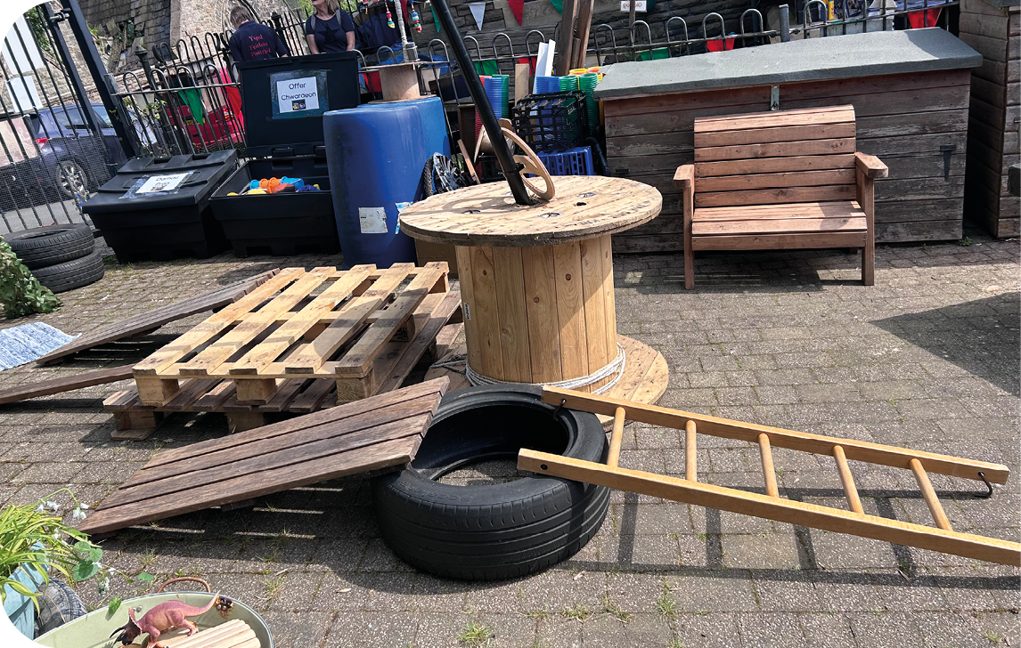
Introduction
The purpose of this resource is to support practitioners in planning to meet the requirements of the A curriculum for funded non-maintained nursery settings (gov.wales)
Having consulted with early years advisory teachers across Wales and following the guidance of the Welsh Government training modules on Hwb, Cwlwm partners co-authored this planning resource. We have looked at examples of planning from several local authorities and developed this resource using the most useful and basic examples. This resource is an example of what could be used when planning for experiences and for the indoor and outdoor environments.
When working through this resource start with a ‘calendar of events/core experiences’. We have provided an example of what could be included. These templates could be used to plan authentic and purposeful experiences for your children. By following the layout we suggest, you as the ‘enabling adults’ will design ‘effective environments’ and ‘engaging experiences’.
Planning continues to be an essential element in providing the highest quality experiences for young children.
This resource is a basic guideline and just an example. You can add to or modify the templates as you like.
You will find full interpretations of these in the curriculum.

Slide 3
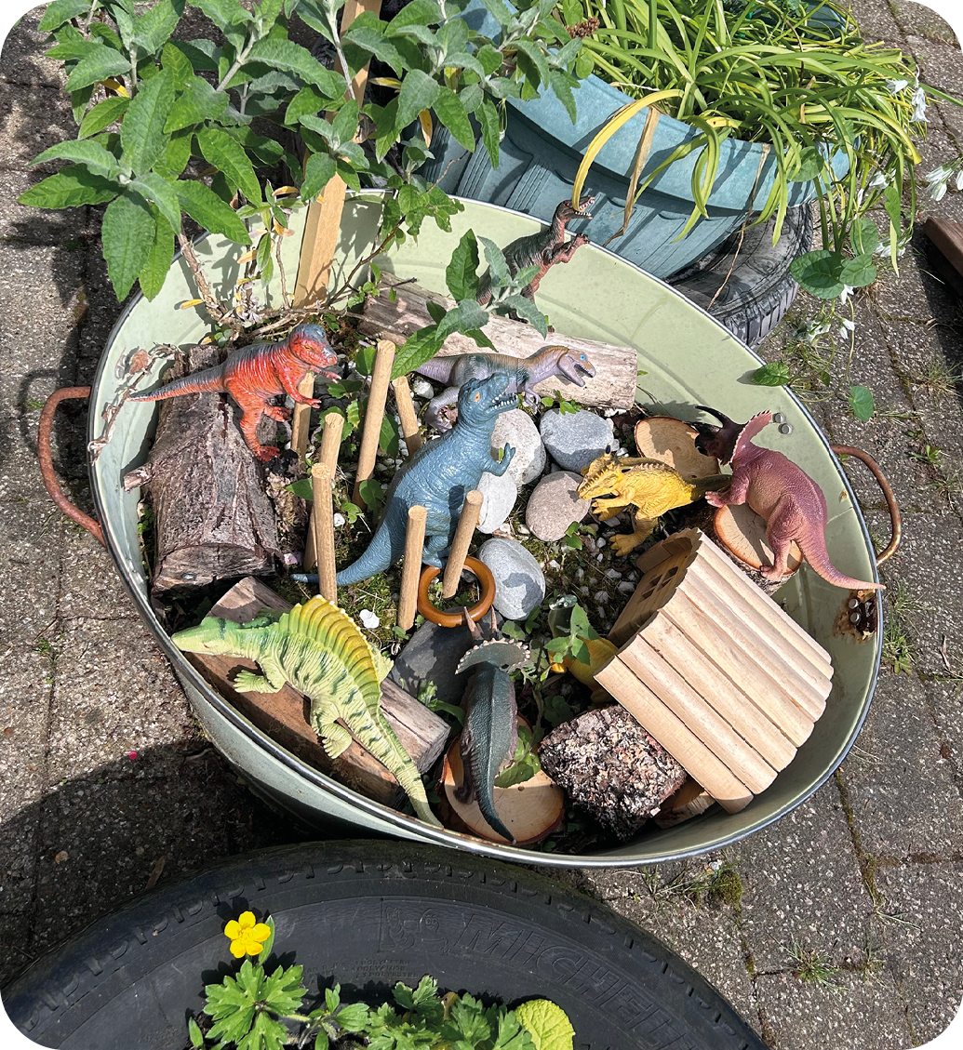
The first step towards ‘reflective/responsive planning’ is to know your children. This can be achieved by discussing your children, their backgrounds, experiences and interests with parents/carers. Take time to get to know your children, their families and their communities and how you will communicate with each family. You may have a high
number of children in your setting to observe and you may wonder how to practically follow the interests of all children. A suggested approach may be to use ‘focus children’. The focus/target children are given extra attention but all children are busy and learning all of
the time. You may decide to choose focus/target children on a weekly basis during your staff/team meetings. This can be carried out through the ‘key worker’ approach or agree as a team which children will be your focus/ target children for the following week. You may consider starting with the children who are less confident and taking time to settle.
When observing focus/target children you will get to know these children and develop a bond with them. You will discover what are their likes/dislikes; fascinations and interests. This information can be used to inform your reflective/responsive planning. If a child who is not a focus/target child does something noteworthy or significant to their development, this can be recorded on your notice wall/wow wall and can be analysed and responded to whether that is in the moment or added to your reflective planning. Most importantly, ensure that it is manageable, giving your time and being a emotionally available as an enabling adult is essential. Remember throughout this time to engage with parents and carers and discuss their children to find out as much as possible about the child and their experiences. These form part of your professional dialogue.

Slide 4
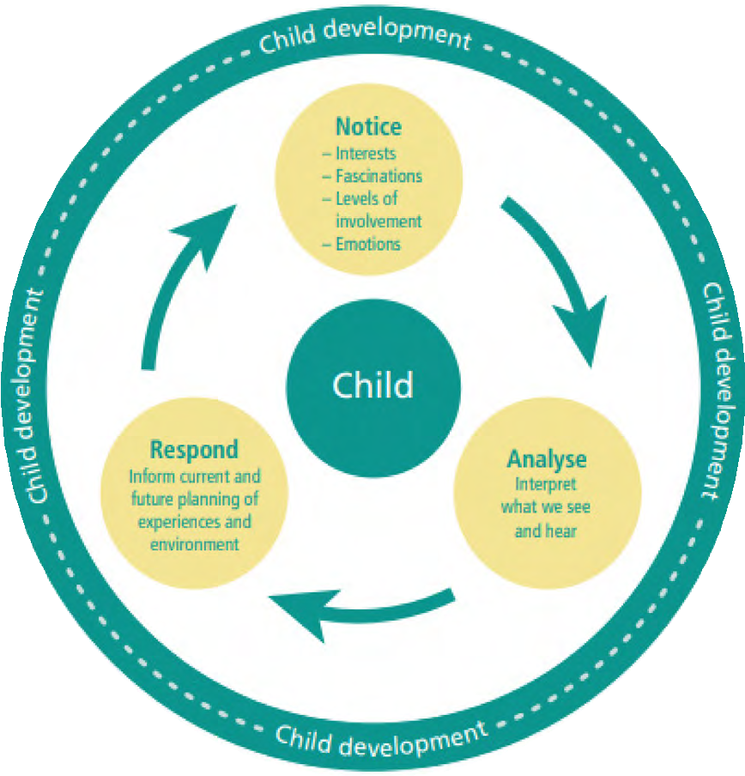
This infographic shows the cycle of how to notice, analyse and respond. This reflective/responsive cycle for planning can influence your practice, environment and experiences there and then, i.e. you can notice something and make an immediate change to enhance or develop the experiences. Or it can be a discussion with your children, staff/team and parents/carers about what to change, add or develop over time. In your staff/team meetings you can discuss and collaborate in analysing what you have noticed to respond effectively for your children and the environments. Remember that one of your best resources is your staff/ team and what they contribute – consult with your staff/team constantly. This is also ‘professional dialogue’.
Infographic from
A curriculum for funded non-maintained nursery settings (gov.wales)​

Slide 5
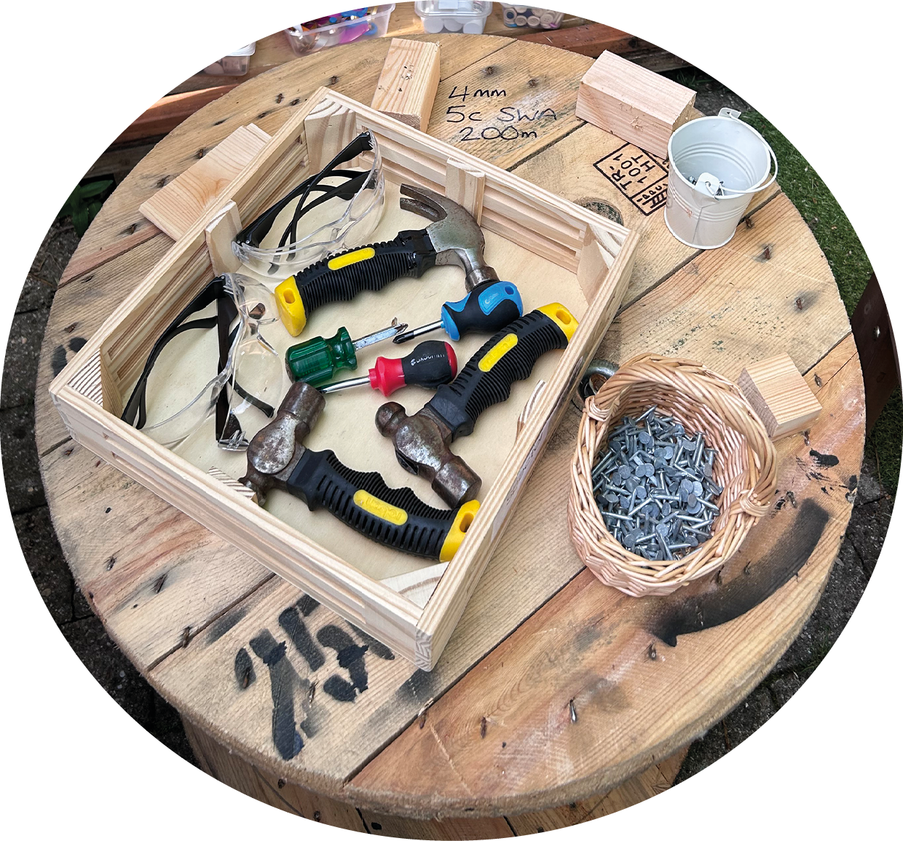
By following this cycle you will –
Notice –
what interests your children and engages their curiosity
how children approach resources and spaces
how children communicate and interact (socialise) with others
Analyse –
what you see and hear and determine whether the observation is significant (important) for that child and therefore worth noting
what are the barriers that prevent your children communicating, interacting and developing their skills
by talking to and listening to your children, parents/carers and colleagues about their previous experiences
Respond –
by making a decision of what to do next to help each child develop holistically
by developing, adapting and adding to the environment or experiences
by modelling with confidence and positivity
by investing time and being emotionally available

Slide 6
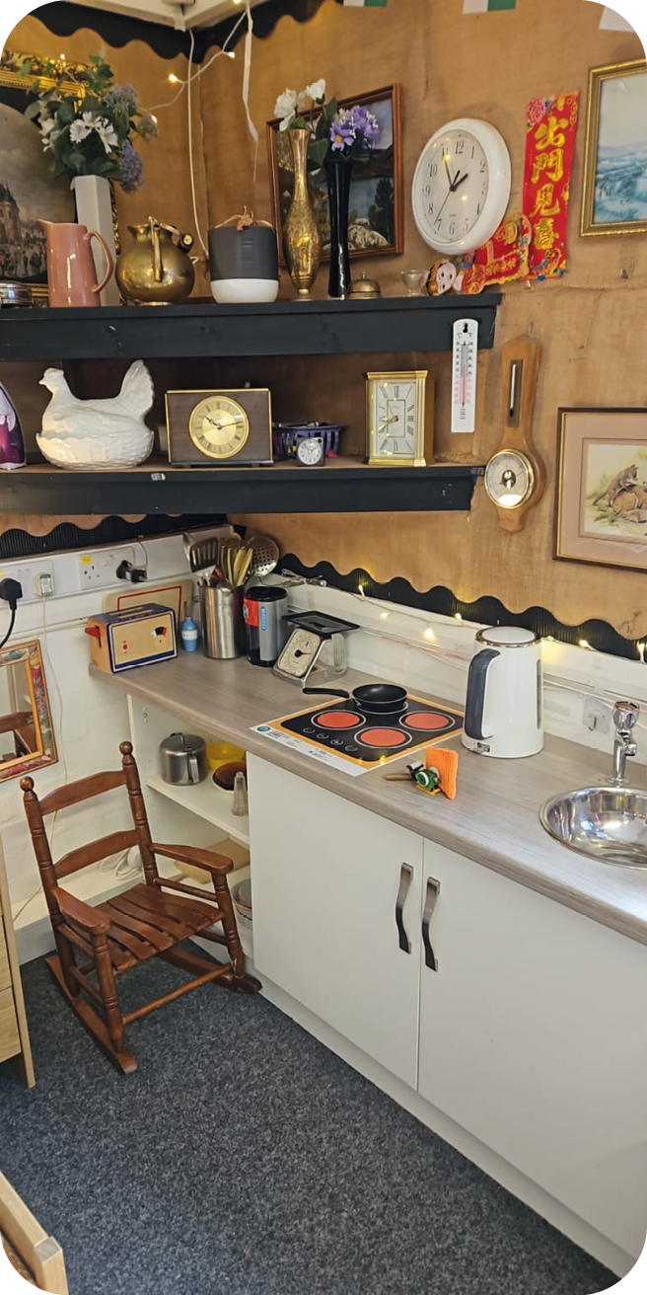
There are Assessment arrangements for funded non-maintained nursery settings - Hwb (gov.wales) developed by practitioners for practitioners that have adopted the curriculum for funded non-maintained nursery settings.
The reflective/responsive planning will take place organically in your settings, with your children, your families and your staff/
team. Remember, when you offer or set out resources, that they are accessible to all children.
You will find brief explanations of the developmental pathways in the curriculum. The developmental pathways represent a child’s right to experience an environment where play is valued in itself and as part of learning. The five developmental pathways should be used holistically when planning engaging experiences to ensure children learn in an authentic and purposeful way.’
This resource can be used to plan your calendar of events/core experiences and your indoor and outdoor environments. We have suggested the types of resources and invitations to play and learn – these are examples only and should not be used as a tick box. An invitation to play and learn
is a collection of resources set up to invite a scenario where children can ignite their
curiosity and spark awe and wonder. This is especially effective if you notice children are not visiting a certain part of your environment. Whilst observing your children you may find that they are showing a particular interest in an unexpected or unplanned event which offers opportunity for learning. These are your ‘teachable moments’. They provide meaningful contexts for adults to introduce or expand on something or which arouses the curiosity of the child.

Slide 7
Belonging | Communication | Exploration | Physical development | Well-being
To the young child a feeling of happiness, well-being and feeling safe in the setting is essential | For effective learning, children need to understand others and make themselves understood | Children’s natural curiosity about the world around them is a strong motivator for exploration | All children have a natural need to move, or be moved, and to move and manipulate objects, often repeatedly as part of their development | Feeling connected, secure and safe are key elements to developing a strong sense of well-being

